Slide 1
CIA TRAINING
CIA TRAINING
Training That Counts
Training That Counts
Presented By
Andrew Stretton
January 2018
Presented By
Andrew Stretton January 2018

Slide 2
The Staff
Andy Burns
Secretarial Skills Trainer
Peter Hums
Training Needs Assessment Officer
Ralph Shine Assistant Manager
Kay Murrey
Secretarial Skills Trainer
Martin Kay
IT Skills Trainer
Pauline Bees Manager
Hazal Marks
Personal Assistant
Peter Lock
Becky Blane
Administration Assistants
Mark Duke
Administration Assistant
Clare Gain
Administration Assistant

Slide 3
Company Ethic
To Be Fair Minded
To Provide Equal Opportunities For All
To Encourage Self Improvement
To Reward Good Performance

Slide 4
Health & Safety
Work Station Safety
Electrical Safety
Staff Facilities
If You Have An Accident

Slide 5
Training Courses
Microsoft Office
Word
Excel
PowerPoint
Access
Publisher
Software Skills
Time Management
Assertive Skills
Leadership Skills
Customer Care

Slide 6
Training Programme
Training Will Include:
Software Skills Training
IT Training
Report Procedure Training
Public Speaking Skills
Training Needs Assessment

Slide 7
Product Sales Jan - Apr

Slide 8
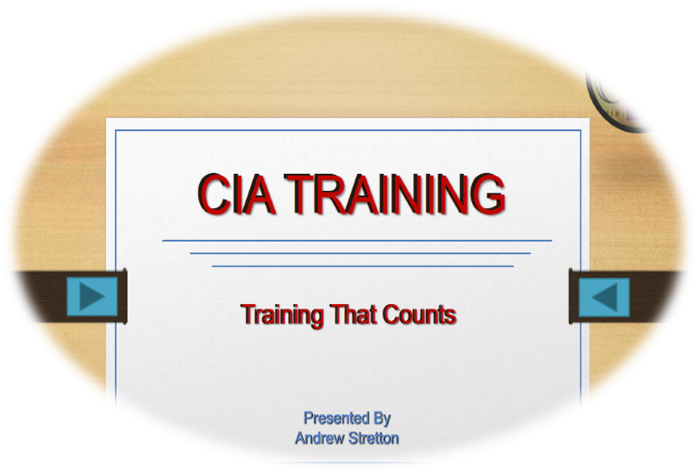
Slide Shows
1. Advanced PowerPoint 2013 - 2016 Animation Presentation Book Next
2. Advanced PowerPoint 2013 Animation Presentation (BROWSER GUIDED) Book Next

